Slide 1
Employee Attrition DATA SCIENCE PROEJCT
Final REPORT

Slide 2
AGENDA
Data Science Lifecycle
Project Overview
Process Overview
Data
Analysis
Modelling
Model Evaluation

Slide 3
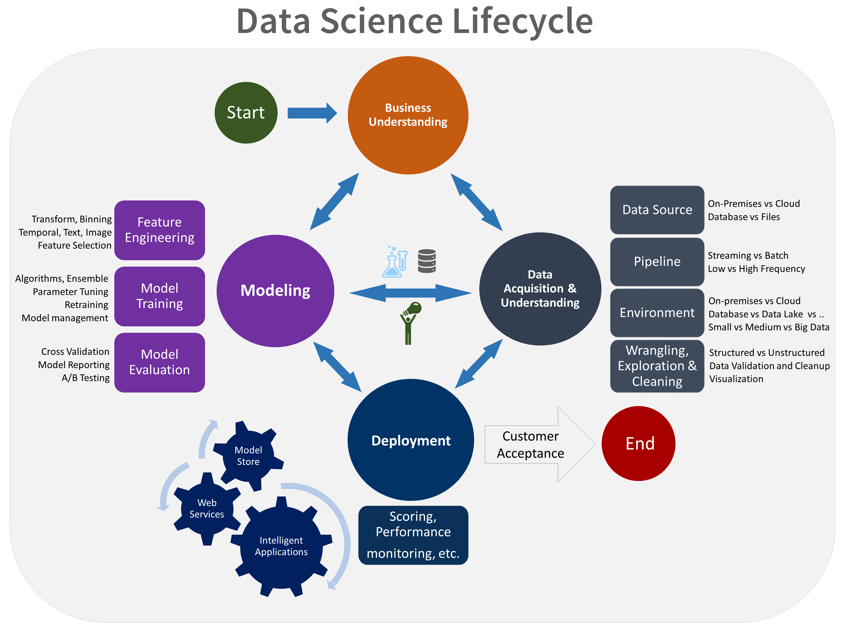
Data science lifecycle

Slide 4
Project overview
Business Problem: The Human resources department is facing a problem of high attrition rates, which is increasing their recruitment cost.
Business Objective: To Reduce the attrition rates by analysing the historical data and create machine learning models to predicting which category of employees have high probability to leave the company.

Slide 5
Process Overview
The Machine Learning Model will be deployed on the cloud platform. Upon that the HR stakeholder can enter the details of the employees and the ML model will predict based on the feature provided whether this particular employee will leave or not.

Slide 6
DATA
Total Number of records: 1470
Total Number of columns: 35
The Number of numerical columns: 26
The Number of categorical columns: 9
Target:
Attrition : No : 1233,
Yes: 237

Slide 7
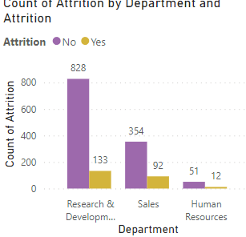
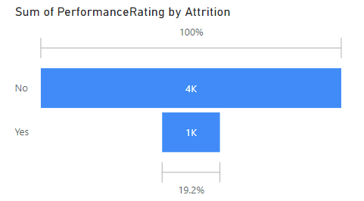
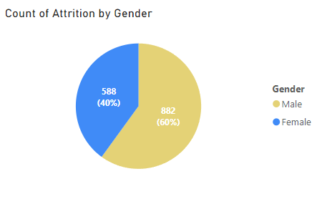
analysis

Slide 8
Inferences based on the graphs
From the funnel chart we can see that the high performance employee have not left the organisation.
Male employee accounted for 60% attrition rate.
Feature like overtime, years at company and year since last promotion have shown high predictability.

Slide 9
Modelling
Logistic Regression: Logistic regression is use for classification problems where we have to predict the binary classes like ‘yes’ or ‘no’, ‘0’ or ‘1’. It uses sigmoid function to give us a ‘S’ shaped line. In this project we have to predict whether the customer has churned or not churned which encoded as ‘no’:’0’, ‘yes’:’1’.
Decision Tree: Decision trees are a type of algorithm used in machine learning. Unlike some other methods, they don't rely on strict rules about how data should look. Instead, they can adapt to different shapes and patterns in the data they're given.

Slide 10
Model Evaluation
Confusion matrix – Confusion matrix is evaluation tool for classification problems in machine learning. There are four quadrants in confusion matrix – True Positives, True Negatives, False Positives and False Negatives. Confusion matrix also helps us to calculate the accuracy of the model.
Model | Accuracy score
Logistic Regression | 71%
Decsion Tree | 80%
Random Forest | 84%

Slide 11
Findings
We have used accuracy score as a evaluation metrics for this project, Accuracy is the sum of all correct prediction made by the model over all prediction made.
Random Forest model has given us the best accuracy score.

